Slide 1
Module 2
Cloud Computing
CS G527
Dr. D.V.N. Siva Kumar
CSIS Department, BITS Pilani, Hyderabad Campus

Slide 2
Virtualization
Agenda
Introduction to Virtualization
Use & demerits of Virtualization
Types of Virtualization and Examples
x86 Hardware Virtualization

Slide 3
Cloud Infrastructures
Key Technology is Virtualization
App
App
App
App
App
App
OS
OS
OS
Operating System
Hypervisor
Hardware
Hardware
Traditional Stack
Virtualized Stack
Virtualization plays an important role as an enabling technology for datacentre implementation by abstracting compute, network, and storage service platforms from the underlying physical hardware
Notes:
Virtualization is simulating a hardware platform, operating system, storage device or network resources

Slide 4
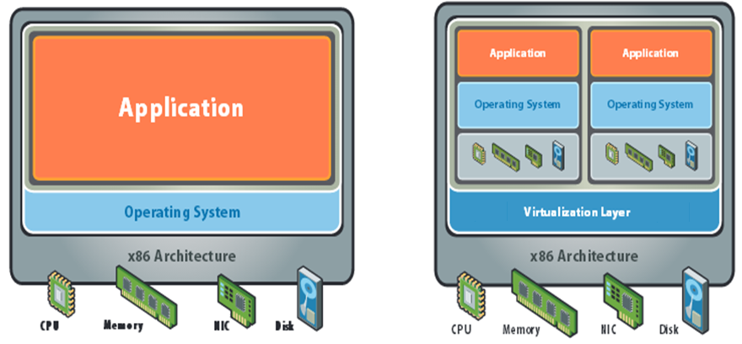
What is Virtualization?
Virtualization is the "creation of a virtual (rather than actual) version of something, such as a server, a desktop, a storage device, an operating system or network resources".
In other words, Virtualization is a technique, which allows to share a single physical instance of a resource or an application among multiple customers and organizations. It does by assigning a logical name to a physical storage and providing a pointer to that physical resource when demanded.

Slide 5
Key Properties of Virtualization
Partitioning
Run multiple operating systems on one physical machine.
Divide system resources between virtual machines.
Isolation
Provide fault and security isolation at the hardware level.
Preserve performance with advanced resource controls.
Encapsulation
Save the entire state of a virtual machine to files.
Move and copy virtual machines as easily as moving and copying files.
Hardware Independence
Provision or migrate any virtual machine to any physical server.

Slide 6
Benefits of Virtualization
More flexible and efficient allocation of resources.
Improves Security
Enhance development productivity.
It lowers the cost of IT infrastructure.
Remote access and rapid scalability.
High availability and disaster recovery.
Pay per use of the IT infrastructure on demand.
Enables running multiple operating systems.

Slide 7
Goals of Virtualization
How to virtualize CPU?.
How to virtualize Memory?.
How to virtualize I/O?.

Slide 8
Virtualization Providers
Microsoft: Virtual PC, Virtual Server 2005, Hyper-V
VMWare: Vmware Workstation, Vmware Server
Oracle: Oracle VM VirtualBox

Slide 9
Virtual Machine
Virtual Machine is a result of Virtualization, which typically refers to the creation of virtual machine that can virtualize all of the hardware resources, including processors, memory, storage, and network connectivity.
VM can be treated as tightly isolated software container with an operating system and application inside.
Each self-contained VM is completely independent.
Putting multiple VMs on a single computer enables several operating systems and applications to run on just one physical server, or “host.”

Slide 10
Hypervisor (Virtual Machine Monitor)
The software responsible for system virtualization is called the Virtual machine Monitor (VMM) or Hypervisor.
The software is used in two ways (three different structures):
- Bare-Metal or Native Hypervisors: Run directly on the hardware. Examples are VMWare ESX server and KVM
- Hosted Hypervisors: Run on top of existing OS and leverage the features of the underlying OS. Examples are VMWare ESX server,
- Hybrid Hypervisors: Run directly on the hardware, but leverage the features of an existing OS running as a guest. Examples are Xen and Microsoft’s Hyper-V

Slide 11
How does Virtualization work?
Hypervisor separate the physical resources from the virtual environments—the things that need those resources.
Hypervisors take our physical resources and divide them up so that virtual environments can use them.
Resources are partitioned as needed from the physical environment to the many virtual environments.
Users interact with and run computations within the virtual environment (typically called a guest machine or virtual machine).
When the virtual environment is running and a user or program issues an instruction that requires additional resources from the physical environment, the hypervisor relays the request to the physical system and caches the changes—which all happens at close to native speed (subjected to the type of hypervisor)

Slide 12
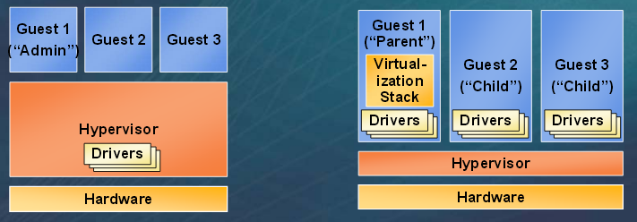
Hypervisor
Monolithic versus Microkernelized
Monolithic hypervisor
Simpler than a modern kernel, but still complex
Contains its own drivers model
Microkernelized hypervisor
Simple partitioning functionality
Increase reliability and minimize lowest level of the TCB
No third-party code
Drivers run within guests

Slide 13
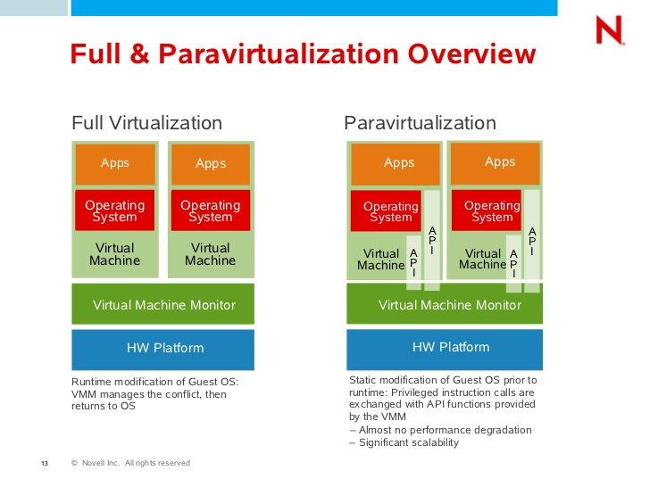
Two Popular Approaches for Server Virtualization
Notes:
RL 2.3

Slide 14
Full Virtualization
Full virtualization
In its basic form known as “full virtualization” the hypervisor provides a fully emulated machine in which an operating system can run. VMWare is a good example.
Full virtualization is achieved by using a combination of binary translation and direct execution. In this type of virtualization, hypervisor translates all privileged instructions (from machine code of guest OS to machine code of host OS) on the fly and caches the results for future use, while user level instructions run unmodified at native speed.
Guest OS doesn’t see that is used in an emulated environment.
The biggest advantage to this approach is its flexibility: one could run a RISC-based OS as a guest on an Intel-based host.
While this is an obvious approach, there are significant performance problems in trying to emulate a complete set of hardware in software.

Slide 15
Advantages and Drawbacks of Full Virtualization
Advantages:
Isolates VMs from each host OS and from each other.
Controls individual VM access to system resources, preventing an unstable VM from impacting system performance.
Total VM portability: VMs have the ability to transparently move between hosts with dissimilar hardware without any problems. A VM running on a Dell Server can be relocated to a HP Server.
Drawbacks:
Performance due to binary translation of specific privileged instructions.

Slide 16
ParaVirtualization / OS Assisted Virtualization
Paravirtualization
“Paravirtualization,” found in the XenSource, open source Xen product.
Paravirtualization uses slightly altered versions of the operating system which allows access to the hardware resources directly as managed by the hypervisor.
This typically involves replacing any privileged operations that will only run in CPU with calls to the hypervisor (known as hypercalls). The hypervisor in turn performs the task on behalf of the guest kernel and also provides hypercall interfaces for other critical kernel operations such as memory management, interrupt handling, etc.
Here, the guest OS is modified version and thus run kernel level specific instructions.

Slide 17
ParaVirtualization (Cont…)
In order to retain flexibility, the guest OS is not tied to its host OS. Drastically different operating systems can be running in a hypervisor at the same time, just as they can under full virtualization.
Privileged instruction translation by the VMM (Hypervisor) is not necessary.
Guest OS uses a specialized API to talk to the VMM and execute the privileged instructions.
In this way, paravirtualization can be thought of as a low-overhead full virtualization.

Slide 18
Advantages and Drawbacks of ParaVirtualization
Advantages:
Significant performance improvement.
Drawbacks:
Requires the modified Guest OSes.
Guest OS could expose the host to security threats due to the direct communication line.

Slide 19
Could you give me an example scenario where one application requires Windows OS?.

Slide 20
Could you give me an example scenario where one application requires Windows OS?.
Ans: An application that is developed using .NET requires Windows OS and

Slide 21
What are the few examples of Hypervisors that are available for use.?
Why should a separate computer system is required for hosting an application?

Slide 22
What are the few examples of Hypervisors that are available for use.?
Ans: Oracle Virtual Box and Hyper-V, etc.
Why should a separate computer system is required for hosting an application?
Ans:
To ensure speed, scalability, and reliability.
To identify the reasons for the problems encountered while accessing application, etc.

Slide 23
Virtualization Versus Cloud Computing
?
Virtualization is software that makes computing environments independent of physical infrastructure, while cloud computing is a service that delivers shared computing resources (software and/or data) on demand via the Internet.
Note: organizations begin by virtualizing their servers and then moving to cloud computing for even greater agility and self-service.

Slide 24
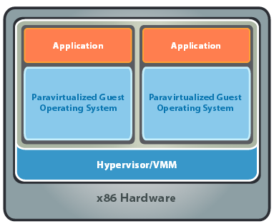
x86 Hardware Virtualization
The latest generation of x86-based systems feature processors with 64-bit extensions supporting very large memory capacities.
This enhances their ability to host large, memory-intensive applications, as well as allowing many more virtual machines to be hosted by a physical server deployed within a virtual infra-structure.
The continual decrease in memory costs will further accelerate this trend.

Slide 25
x86 Hardware Virtualization
For Industry-standard x86 systems, the two approaches typically used with software-based partitioning are
Type 1 Hypervisor (also called bare metal or native)
Type 2 Hypervisor (also known as hosted hypervisors)

Slide 26
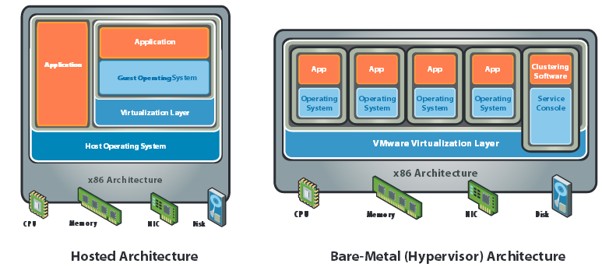
x86 Hardware Virtualization

Slide 27
Type 1 Hypervisor (also called as Bare-metal hypervisor)
A bare-metal hypervisor (Type 1) is a layer of software we install directly on top of a physical server and its underlying hardware.
There is no software or any operating system in between, hence the name bare-metal hypervisor.
A Type 1 hypervisor is proven in providing excellent performance and stability since it does not run inside Windows or any other operating system.
Type 1 hypervisors are mainly found in enterprise environments.
It offers high performance since it has direct access to the underlying hardware (and no other Operating Systems and device drivers to content with). Due to this, Type 1 Hypervisor is considered to be the best performing and most efficient.
Two examples of Type 1 Vendors: VMware vSphere, KVM (Kernel-Based Virtual Machine), Citrix Hypervisor (formerly known as Xen Server)

Slide 28
Example Applications of Type 1 Hypervisor
When High-performance computing is required, where any overhead should be avoided, and hardware components are selected and tuned for maximum performance: e.g., computing clusters for silicon chip design.
Imagine building a medical imaging device that needs to process huge medical data in real-time and also simultaneously provide an interactive GUI to users. Both the real-time OS and general purpose can be run simultaneously.

Slide 29
Type 2 Hypervisor (also called as Hosted Hypervisors)
This type of hypervisor runs inside of an operating system of a physical host machine.
A hosted approach provides partitioning services on top of a standard operating system and supports the broadest range of hardware configurations.
We call type 2 hypervisors – hosted hypervisors. As opposed to type 1 hypervisors that run directly on the hardware, hosted hypervisors have one software layer underneath. In this case we have:
-A physical machine.
-An operating system installed on the hardware (Windows, Linux, macOS).
-A type 2 hypervisor software within that operating system.
-The actual instances of guest virtual machines.
Type 2 hypervisors are typically found in environments with a small number of servers.
Type 2 hypervisors are less efficient than Type 1 since they cannot directly communicate with the hardware due to which they are less efficient than the type 1 hypervisors.

Slide 30
Example Applications of Type 2 Hypervisor
It is used during the development process. It could be used for testing alpha and beta software as each individual VM is isolated from each other. If one VM (may be a VM running beta software) corrupts the operating system, it will not affect any other VM OS and the host OS.
This type of hypervisors enables running applications written for several different operating systems on one computer. One VM may be used for running Windows applications and another VM for running Linux applications. In all such cases, type-2 hypervisors are more suitable.

Slide 31
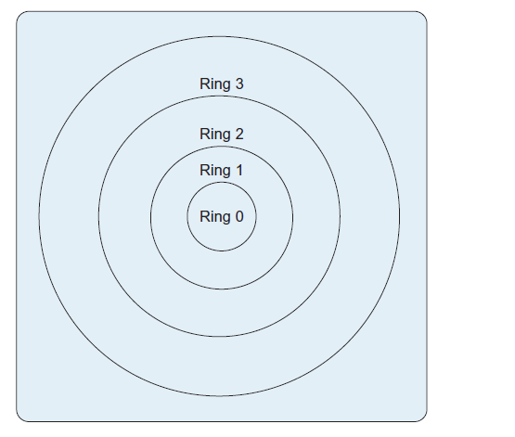
Virtualization Techniques
Trap and Emulate
Binary Translation
Paravirtualization
Hardware Assisted (Intel and AMD created
new processor extensions to support
virtualization in the hardware.)
X86 Protection Rings

Slide 32
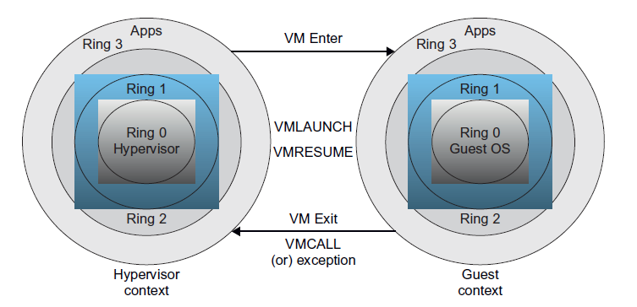
Hardware Support for Processor Virtualization
VT-x, called VanderPool, represents Intel’s technology for virtualization
on x86 processors.
Two modes for processor execution: VMX root operation and VMX non-root
operation

Slide 33
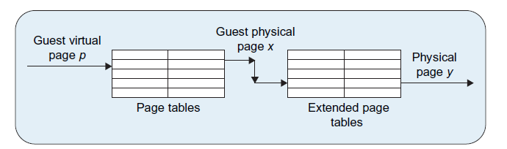
Hardware Support for Memory Virtualization
Extended page tables.

Slide 34
Hardware Support for IO Virtualization
Intel’s VT-d technology can reduce the overhead of I/O virtualization
It has two components, Interrupt Remapping and DMA Remapping
DMA remapping is targeted at eliminating the need for hypervisors to translate guest virtual addresses in I/O commands.
Interrupt remapping is a technology that allows the hypervisor to ensure
that interrupts from I/O devices can be delivered directly to the appropriate guest.

Slide 35
Two Popular Hypervisors
Vmware
Xen
Note: In general, all hypervisors need some operating system-level components—such as a memory manager, process scheduler, input/output (I/O) stack, device drivers, security manager, a network stack, and more—to run VMs.

Slide 36
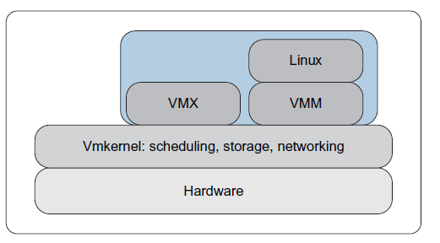
VMware
VM virtualization:
For CPU virtualization, the VMM uses a combination of binary transalation and VT-x.
VMM uses a paravirtualization for I/O virtulization.
High-level architecture of VMware ESX 3i server

Slide 37
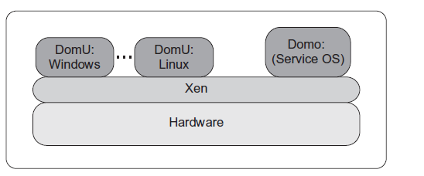
Xenserver Architecture
Guest VMs are called Domains.
Domain 0 is a specialy privileged VM that access to the physical hardware.
It makes use of paravirtulization for I/O virtulization; (I/O requsts from any other non-domain 0 VM (called as DomU) are sent to Dom0.

Slide 38
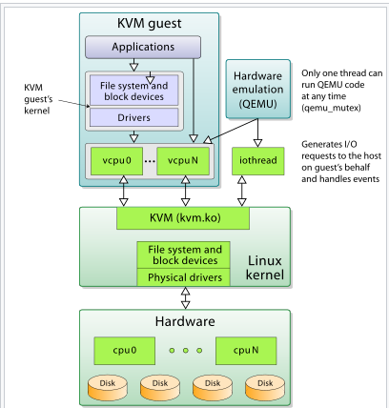
KVM (Kernel-based Virtual Machine)
KVM is an open source virtualization technology built into Linux
KVM turns Linux into a hypervisor that allows a host machine to run multiple, isolated virtual environments called guests or virtual machines (VMs).
KVM provides hardware-assisted virtualization for a
wide variety of guest operating systems
(Linux, Solaris, Windows, macOS, etc.)
Note: KVM can only be used on a processor
with hardware virtualisation extensions
such as Intel-VT or AMD-V
Ref: https://ubuntu.com/blog/kvm-hyphervisor
https://en.wikipedia.org/wiki/Kernel-based_Virtual_Machine

Slide 39
Advantages of Virtualization
Security
Reliability and Availability
Cost
Adoptability to workload variations
Load balancing
Support for legacy applications

Slide 40
Issues with Virtualization
Software licensing
IT training
Hardware investment
Interoperability between various vendors

Slide 41
Can we have a single VM on multiple systems?
Can you run multiple virtual machines at once?

Slide 42
Can we have a single VM on multiple systems?
Ans: No, Virtual machines run on a single OS.
Can you run multiple virtual machines at once?
Ans: Yes, you can run multiple virtual machines at once.

Slide 43
Few Questions
Could you give me an example of Hosted Architecture based Virtualization?
Could you give me an example of Bare-Metal (Hypervisor) Architecture based virtualization?

Slide 44
Few Questions
Could you give me an example of Hosted Architecture based virtualization?
Ans: Vmware Workstation and Oracle Virtual Box.
Could you give me an example of Bare-Metal (Hypervisor) Architecture?
Ans: VMware ESX Server employs a hypervisor architecture on certified hardware for data center class performance. Openstack also supports.

Slide 45
Which hypervisor does Google Compute Engine (GCP) use for creating VMs?.
Ans: KVM
Which hypervisor does AWS use for creating VMs?.
Ans: Modified verisions of KVM (Nitro)

Slide 46
What problems we face with the current virtualization techniques?
Ans:
Portability of one application from one environment to another across several devices.
Challenges in Software build up (redeployment or reconfiguration or recompilation of the software whenever we want to ship one package from one environment to other.)
More booting time for virtual machines to start.
Possibility of more resource wastage.

Slide 47
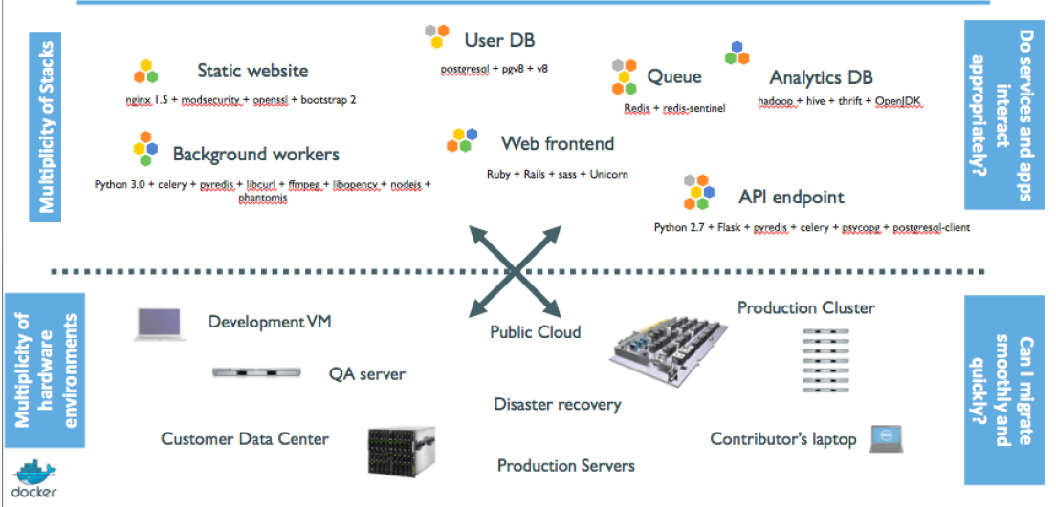
Current Problem the Industry is facing

Slide 48
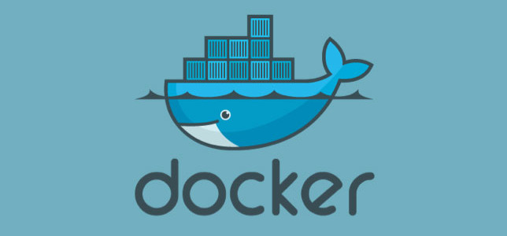
Reference: Getting Started with Docker by Author: Christopher M. Judd (For detailed information about dockers)
Notes:
RL 2.4

Slide 49
Why Dockers are required?

Slide 50
Why Dockers are required? (Cont…)
Docker is a software platform that allows you to build, test, and deploy applications quickly.
It is mainly for:
Application Level Virtualization
Build once, deploy anywhere and run any where.
Better collaboration while development of applications.
A single host can run several applications for proper utilization of resources.
Note1 : Docker enables developers to easily pack, ship, and run any application as a lightweight, portable, self-sufficient container, which can run virtually anywhere.
Note 2: The whole idea of Docker is for developers to easily develop applications, ship them into containers which can then be deployed anywhere.

Slide 51

Dockers
It is an open-source project that automates the deployment of applications inside software containers.
All applications have their own dependencies, which include both software and hardware resources.
Docker is a mechanism that helps in isolating the dependencies per each application by packing them into containers.
In terms of technology, it provides portability by running the same applications in different environments.
Containers are scalable and safer to use and deploy as compared to regular approaches.
Note: The Dockers can also be called as container-based virtualization or Lightweight virtualization.

Slide 52
How are Docker Containers different from a Virtual Machine?
Virtual machines have a full OS with its own memory management installed with the associated overhead of virtual device drivers.
Docker containers are executed with the Docker engine rather than the hypervisor.
Containers are therefore smaller than Virtual Machines and enable faster start up with better performance, less isolation and greater compatibility possible due to sharing of the host’s kernel.

Slide 53
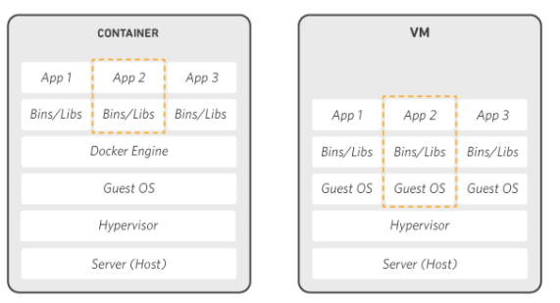
How are Docker Containers different from a Virtual Machine?
Ref: https://aws.amazon.com/docker/

Slide 54
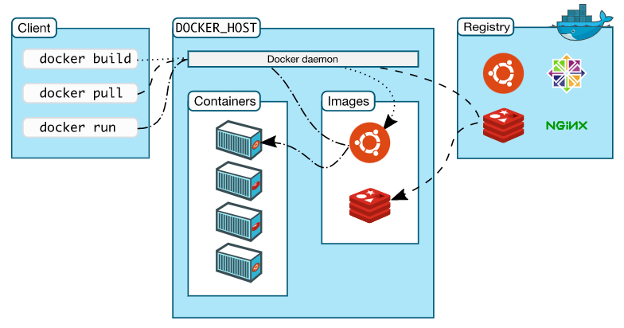
Docker Architecture

Slide 55
Image and Container
Image: An image is a read-only template with instructions for creating a Docker container. For example, build an image which is based on the ubuntu image, but install the Apache web server and our application, as well as the configuration details needed to make our application run.
Note: You might create your own images or you might only use those created by others and published in a registry.
Container:
- Docker provides the ability to package and run an application in a loosely isolated environment called a container.
- A container is a runnable instance of an image. You can create, start, stop, move, or delete a container using the Docker API or CLI.
-We can connect a container to one or more networks, attach storage to it, or even create a new image based on its current state.

Slide 56
Docker Components
Docker for Mac − To run Docker containers on the Mac OS.
Docker for Linux − To run Docker containers on the Linux OS.
Docker for Windows − To run Docker containers on the Windows OS.
Docker Engine − For building Docker images and creating Docker containers.
Docker Hub − It is the registry which is used to host various Docker images.
Docker Compose − This is used to define applications using multiple Docker containers.

Slide 57
Docker Features
It has the ability to reduce the size of development by providing a smaller footprint of the operating system via containers.
Can be deployed anywhere, on any physical machine (Mobile, System, Server), virtual machine and even in cloud.
Higher scalability since containers are lightweight.

Slide 58
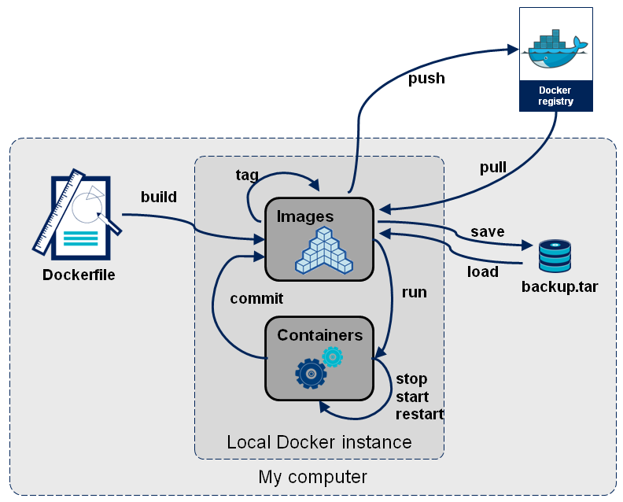
Docker Container Lifecycle ……

Slide 59
Docker Container Lifecycle ……
• The Life of a Container
– Conception
• BUILD an Image from a Dockerfile
– Birth
• RUN (create+start) a container
– Reproduction
• COMMIT (persist) a container to a new image
• RUN a new container from an image
– Sleep
• KILL a running container
– Wake
• START a stopped container
– Death
• RM (delete) a stopped container
• Extinction
– RMI a container image (delete image)

Slide 60
Dockerfile ……
• Like a Makefile (shell script with keywords)
• Extends from a Base Image
• Results in a new Docker Image
• Imperative, not Declarative
A Docker file lists the steps needed to build an images
• docker build is used to run a Docker file
• Can define default command for docker run, ports to expose, etc

Slide 61
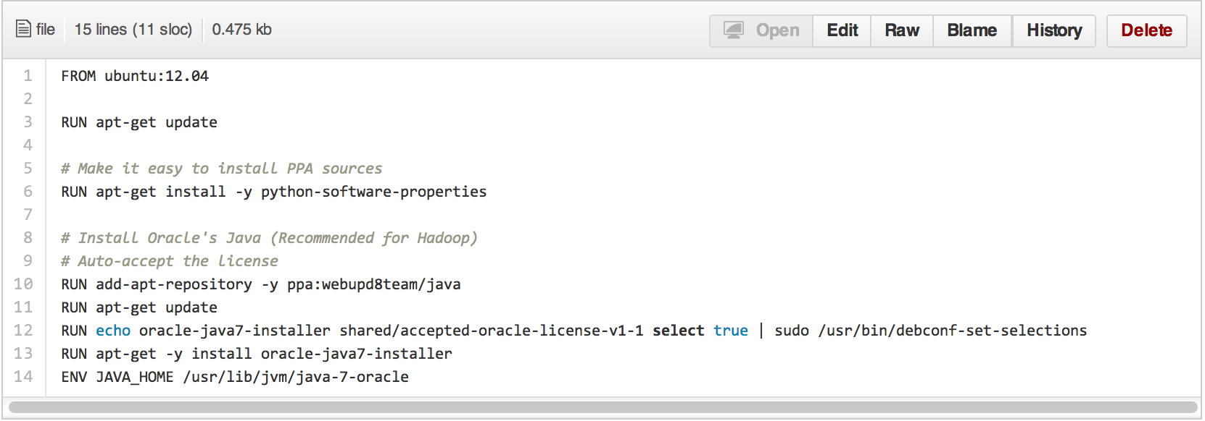
Example of a Dockerfile

Slide 62
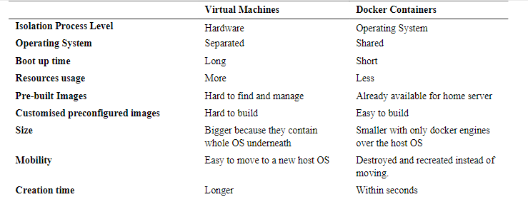
Differences between Virtual Machines and Docker Containers

Slide 63
Security concerns with Dockers
Kernel exploitations
Denial-of-service attacks
Container breakouts
Poisoned images
Reference: https://www.oreilly.com/content/five-security-concerns-when-using-docker/

Slide 64
When to use Virtualization?
When to use Containization?

Slide 65
Video Lectures of Demonstrating Hypervisors
https://www.youtube.com/embed/phCWC7AgxYM?modestbranding=1&showsearch=0&autohide=1&showinfo=0&rel=0&frameborder=0 (Demonstration of installing Ubuntu OS using hypervisor called “Oracle Virtual Box”)
https://www.youtube.com/embed/EYqwMulUKWY?modestbranding=1&showsearch=0&autohide=1&showinfo=0&rel=0&frameborder=0 (Demonstration of installing Ubuntu OS using another hypervisor called “Microsoft Hyper-V)
https://www.princeton.edu/~rblee/ELE572Papers/Fall04Readings/secureOS/popek_virtualizable.pdf (Formal Requirements for Virtualizable Third Generation Architectures )
Notes:
Distributed Management of Virtual Machines
Managing VMs need to set up custom software environments for VMs, setting up and managing networking for interrelated VMs, and reducing the various overheads involved in using VMs. Thus, VI managers must be able to efficiently orchestrate all these different tasks.
Reservation-Based Provisioning of Virtualized Resources
Determination of the demand for resources is known beforehand so that the computational resources must be available at exactly that time to process the data produced by the equipment
Provisioning to Meet SLA Commitments
IaaS clouds can be used to deploy services that will be consumed by users other than the one that deployed the services. cloud providers are typically not directly exposed to the service semantics or the SLAs that service owners may contract with their end users. The capacity requirements are, thus, less predictable and more elastic.

Slide 66
References
https://blackberry.qnx.com/content/dam/qnx/whitepapers/2017/what-is-a-hypervisor-and-how-does-it-work-pt1.pdf
https://www.citefactor.org/journal/pdf/A-Virtualization-Approach-in-Smart-phone-Using-Cloud-computing-for-machine-to-machine-Communication.pdf
http://dsc.soic.indiana.edu/publications/virtualization.pdf
https://www.vmware.com/in/solutions/virtualization.html
https://courses.cs.washington.edu/courses/cse451/18sp/readings/virtualization.pdf
Getting Started with Docker by Author: Christopher M. Judd (For detailed information about Docker architecture)
https://reader.elsevier.com/reader/sd/pii/S0140366417300956?token=1BD05F31679AFAE6D696EDCF93DA910B51D2CDB3CDEA5A1B88AB87B6E50DD62AA0DB365B7AB9CD83A29F0C9568058F34&originRegion=eu-west-1&originCreation=20220205092527 (Dockers)
https://reader.elsevier.com/reader/sd/pii/S1877050920311315?token=12D4662BF758D895621AEC6D7BFA5017249B01073B19B65D815E5DA9BF802399AEC3308F55520B7B4B19FFD993C62B46&originRegion=eu-west-1&originCreation=20220205092613 (Dockers)

